Slide 1
Outagamie County Local Court Rules Procedure to Waive Annual Accounting Requirements
Brent Haroldson – Outagamie County Register in Probate

Slide 2
Outagamie County Local Rule 7(a) Criteria that must be satisfied to request a waiver
a. A guardian of estate, who is not a corporate guardian, may request that a ward’s accounting be waived only if each of the following criteria are met as of December 31st of the year for which a waiver is sought:
i. The guardian of estate/conservator has been appointed for 12 months or more and submitted an annual accounting for a full calendar year on at least once occasion;
ii. The ward’s income for the year is less than 150% of annual poverty earnings for one person as set by the US Department of Health and Human Services;
**U.S. Federal Poverty guidelines for one person in 2024 = $15,060.00
**$15,060.00 x 150% = $22,590.00
iii. The ward’s total assets do not exceed $2,000.00. Under this provision, a wards “assets” do not include the following:
1. Burial trusts;
2. Wispact trusts;
3. A second social security deposit made in December of the year for which a waiver is requested that is intended to be social security income for January of the following year.
iv. Each guardian of estate/conservator signs a sworn statement indicating that the ward’s income and assets were used only for the ward’s benefit during the accounting period for which the waiver is requested.

Slide 3
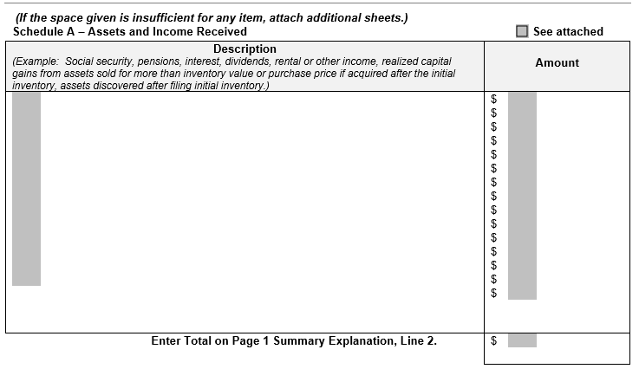
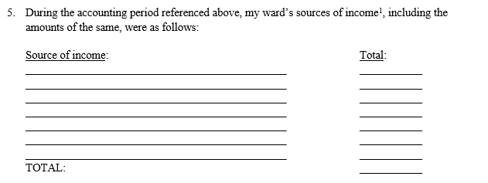

What counts as income under Rule 7(a)(ii)?
All earnings and newly discovered assets, other than interest earned on burial trusts or Wispact Trusts.
Definition applied is the same definition used in Schedule A of the accounting form, but
should not be considered an all inclusive definition.
Examples of additional assets not specifically listed that should be included as income:
Gift of money
Inheritance
Income tax return
Assets belonging to a ward that are sold for less than the amount they are purchased for CANNOT
be utilized to reduce the income of the ward.

Slide 4
Outagamie County Local Rule 7(b) Documents that must be submitted to obtain a waiver
b. All account waivers must be requested on the designated Register in Probate Office Court Form and include the following attachments:
i. Proof of the ward’s total income for the year the waiver request is submitted for;
ii. A bank statement for the month of December for the year the waiver is being requested for each account holding the ward’s assets. These statements must contain the year-end balance for each asset owned by the Ward.

Slide 5
Documents to Attach to Prove the Ward’s Income (Rule 7(b)(i)
W-2 (if ward is employed)
IRS Form SSA-1099
IRS Form 1099-INT
Copies of Paycheck Stubs
Letter from Social Security stating the monthly benefit amount accompanied by bank statements for each month showing the deposit into the account
**Bank statements alone will likely be insufficient. Although it shows all deposits into the guardianship account, it is not clear that those amounts are all of the assets belonging to the ward**

Slide 6
Documents to Attach to Prove the Ward’s Assets
A bank statement showing the December 31st balance of each account holding assets of the ward
Although Wispact Trusts and burial trusts do not counts as assets that apply to the $2,000.00 threshold, please include the statements so current records are maintained in the court record
If the December bank statement ends mid month, the January statement will be necessary to show the value of the ward’s assets on December 31st.

Slide 7
Outagamie County Rule 7(c)
Any waiver received by the Outagamie County Probate Office after February 15th (or the next business day if February 15 is on a weekend/holiday) will be denied and the guardian of estate will be required to prepare a full accounting of their ward’s income and expenses.
Failure to meet the deadline will result in a denial. Deadline is firm and no extensions will be given.
Intention is to have these submitted and reviewed before full annual accounts are filed.
Any requests that are denied will require a full accounting to be completed, so this deadline ensures that guardians can still meet the April 15th deadline to file a full accounting if their request is denied.

Slide 8
What will lead to a waiver request being denied?
Failure to use the Petition and Order to Waive Annual Accounting prepared by the probate office
Guardian(s) have not filed an accounting for a full calendar year
Ward’s income exceeds 150% of annual poverty earnings
Ward’s assets exceed $2,000 on December 31st
Petition is not signed by each co-guardian
Guardian(s) signatures are not notarized
Failure to provide necessary supporting documents for all of the ward’s assets or income
Petition was not filed timely

Slide 9
If denied, can a new request be filed?
Yes, if the denial was due to failing to provide all supporting documents, the lack of a co-guardian’s signature, or the lack of the guardian(s) signatures being notarized. BUT, the new request must be received by the probate office by the filing deadline.
No, if the denial was due to need to account for a full calendar year, the ward’s earnings, of the ward’s assets totaling in excess of $2,000.

Slide 10
Outagamie County Local Rule (7)(d)
The Court shall have the discretion to deny any waiver it deems inappropriate for any reason.
When will this discretion be exercised?
Whenever there is concern that the ward’s assets are being mishandled or when there is concern that local court rules and/or state statutes are not being followed.
Guardian was directed to complete or submit paperwork and the probate office did not receive a response.
Third party notifies court of concerns about the guardian’s management of assets.
History of noncompliance with local court rules (i.e. cash withdrawals and conducting transactions without required court approval)

Slide 11
Wispact Trust vs. ABLE Account
Wispact Trusts are special needs trusts. Court authorization is required to use the ward’s assets to fund the trust, but once created, a ward is a beneficiary of the trust and does not own the account.
ABLE accounts assign a “designated beneficiary”, which would be the individual under guardianship, but the designated beneficiary is also the account owner.
A power of attorney, parent, or guardian may be allowed signature authority over the account, but ownership remains with the “designated beneficiary”

Slide 12
Burial Trust vs. Life Insurance
Burial Trusts are exempt from asset limits, but life insurance policies are not.
Some ward’s own life insurance policies intended to be used for burial expenses, but because the life insurance proceeds paid out in the future are specifically designated for that purpose, the value of a life insurance policy does factor in to the $2,000.00 threshold.

Slide 13
Things to Remember
Waiver requests must be submitted for every accounting year. A waiver granted this year does not waive accounting for future years.
DO NOT withhold assets from a ward’s account to stay under income or asset thresholds in order to obtain a waiver.
If a waiver is granted, or if you anticipate your ward will be eligible for a waiver, it is not an excuse to maintain poor records.
Outagamie County Local Rule 8 sets forth audit procedures.
Guardian must maintain records for 7 years.
Probate office has the authority to request bank statements, receipts, and copies of canceled check associated with any prior accounting year, even if a waiver was granted.
If you are granted a waiver, or if you anticipate your ward will be eligible for a waiver, the guardian is still subject to the local rules regarding the management of a wards assets.
i.e. purchases over $500, no cash transactions, no reimbursement without court approval, no gifting without court approval, mileage rules, etc.

Slide 14
Additional Rule Changes to Keep in Mind
Local Rules no longer require you to update your credit report every four years.
Local Rules permit guardians to petition the court for guardianship fees.
Local Rules now prohibit granting extensions on accounting deadlines.
Local Rules require the signature of all co-guardians even if the letters of guardianship permit co-guardians to act independently.
Expenses incurred from assets held in a Wispact Trust that exceed $500 no longer requires prior court approval.

