Slide 1
Wisconsin Court System E-filing Process
Brent Haroldson
Outagamie County Register in Probate
320 South Walnut Street
Appleton, WI 54911
Disclaimer: This presentation is intended for educational purposes only to introduce participants to the Wisconsin Circuit Court E-filing System. Any interpretation or points of view expressed by the presenter does not necessarily represent, or replace, the official position or policies of the Wisconsin Circuit Court. Nothing in this presentation should be interpreted as legal advice.

Slide 2
GOALS
Introduce individuals interested in using the e-filing system to the information and procedures in place to provide assistance
Increase the layperson’s familiarity with the Wisconsin Court Systems website and the materials available to them to answer questions they might have
Reduce the amount of physical paper exchanged between Probate Office and litigants
Increase efficiency in the exchange of information between Probate Office and litigants

Slide 3
E-filing Statute
Wis. Stat. § 801.18
Individual required to e-file:
Licensed Wisconsin Attorneys
Attorneys appearing under SCR 10.03(4)
High-volume filing agents
A layperson appointed as a guardian of the person or guardian of the estate is not required to e-file
However, once opted in as an e-filing party, you are subject to the e-filing rules and procedures and should not be submitting filings in paper form unless you have withdrawn from the e-filing system
Once opted in, the e-filing system will be how you receive notice and other documents relevant to your ward’s case

Slide 4
“Self-Represented Party vs. Non-party Filer”
Self-Represented Party—a self represented litigant not filing on behalf of a business or corporation
This type of account will give you notice of case activity and access to case documents
You will be able to view prior orders, GAL Bills, correspondence filed with the court, issued letters of guardianship, etc.
Exceptions: confidential documents filed with the court (i.e. doctor’s reports)
“Opt-in” fee: $20.00 (if you are a guardian for more than one ward, there is a fee for each case)
Non-party Filer—an individual or agency filing reports, letters, administrative agency records and return of service.
This type of account will not give you notices of case activity or access to case documents
No “Opt-in” fee

Slide 5
Creating an E-filing Account
E-filing website: http://efiling.wicourts.gov
Required information to create an account
Username and password
Name and address
E-mail address
Mobile phone number
Designate what type of account—”Self-represented party” vs. “Non-party filer”
“Creating an eCourts Account” available on the Wisconsin Court System website with step by step instructions and a video tutorial

Slide 6
Opting in as a self-represented party
Login with user ID and Password
Click “Opt in as an electronic party” along bottom of the page or “Opt in” along the top of the page
Enter the County, Case Number, and “Opt-in” code
This code is generated by the probate office—the probate office will not provide this over the phone; this code will only be provided in person upon presentation of a valid ID or by mail
In the drop down menu you will select yourself – as the court appointed guardian you should be listed as a party, if not, please contact the probate office to make sure you have been added
Click save to proceed to payment screen
Pay the Opt-in fee
Opt-in request will be sent to the Court and you will receive an email from the Court if successful
requests CANNOT be processed without the payment submitted

Slide 7
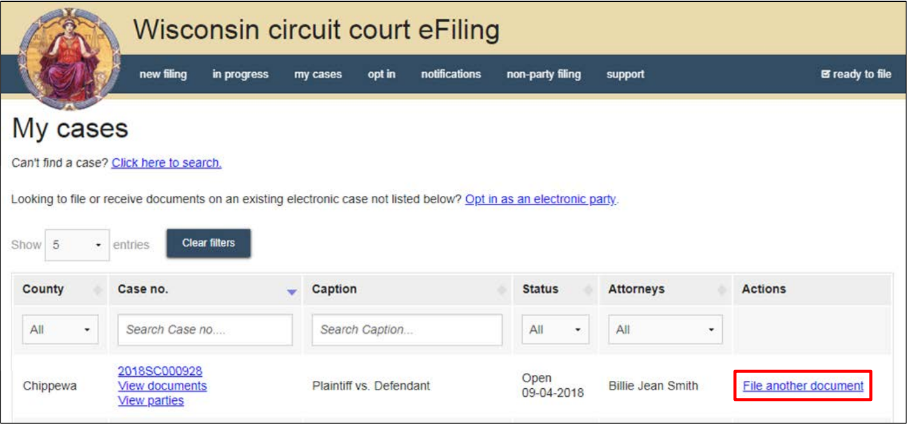
Navigating the Case File
Once opted in you should be able to view any documents that have been scanned into the e-filing system:
Excludes documents that have not been scanned
Exclude confidential documents

Slide 8
Filing new documents
Document Requirements
Must be formatted as either a PDF or a Microsoft Word document (must be Word 2007 or newer)
Must have a ½” margin on top to allow space for court-applied document header
Upper right corner (2” x 2” square) must be blank to allow space for the filing stamp
Use standard fonts in preparing documents (i.e. Calibri, Times New Roman, Arial, etc.)
Documents that require a court signature must leave a 3” margin at the top of the document
Documents submitted may not exceed 10 MB in size (if they do, you must break it up into smaller files)

Slide 9
Filing New Documents
Most Common Documents filed by Guardians
Written Letter to the Court
Annual Account documents
Annual Report on Condition of the Ward
Outagamie County Probate Forms:
Monthly Budget Expense Breakdown
Petition and Approval for Guardian to Make Gifts/Donations
Petition and Approval for Purchases Exceeding $500.00
Petition for Mileage Reimbursement
Petition for Vacation/Travel Expenses
All annual account forms, annual report forms, and Outagamie Probate forms can be obtained online

Slide 10
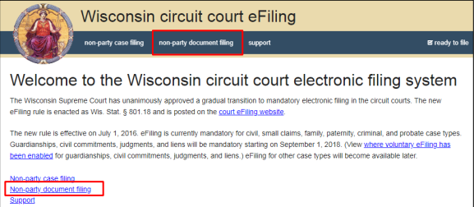
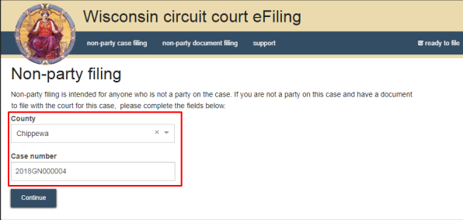
Annual Accounts and Annual Reports
Filing as a Non-Party Filer
Sign into your account with your username and password
Select “non-party document filing”
Enter the county and case number

Slide 11
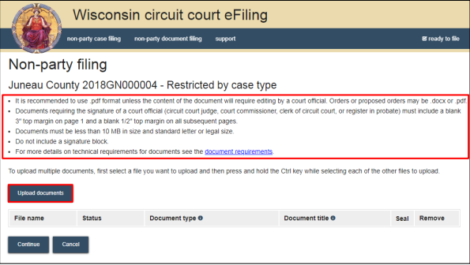
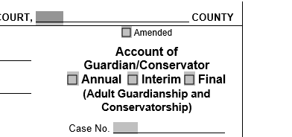
Annual Accounts and Annual Reports
Select “Upload Documents”
This will open up saved files in
your computer and you will select
the documents you wish to file with
the court
Once uploaded, the documents
being filed will appear in the list of
files to be uploaded
Once you have selected the
document type and titled each
document, click “Continue”
Document Type – indicate the type of document you are filing by using the drop down menu or by typing the name of the document you are filing
Document Title – give the document a title
Ex: 2022 Annual Account
2022 Account of Guardian/Conservator
Doe, J – 22GN1234 – 2022 Annual Account
2022 Annual Report on Condition of the Ward

Slide 12
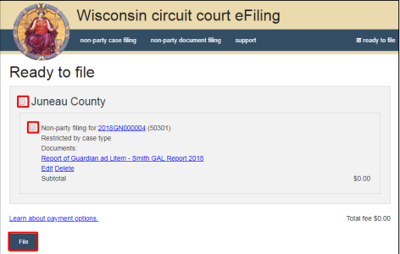
Annual Accounts and Annual Reports
Ready to File
Review information on the screen to make sure it is correct
Confirm case number
Confirm document title
Click “File” – this will submit the document to the court for filing and you will receive a confirmation email once it has been processed by the court.

Slide 13
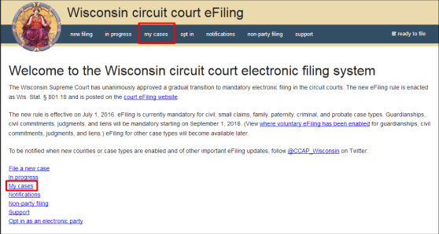
Annual Accounts and Annual Reports
Filing as an Electronic Party
Log in with your username and password
Select “my cases”

Slide 14
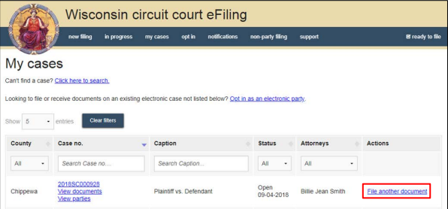
Annual Accounts and Annual Reports
As long as you have already opted in, you should see the case listed in the “my cases” list
Select the “file another document” tab on the right side of the screen

Slide 15
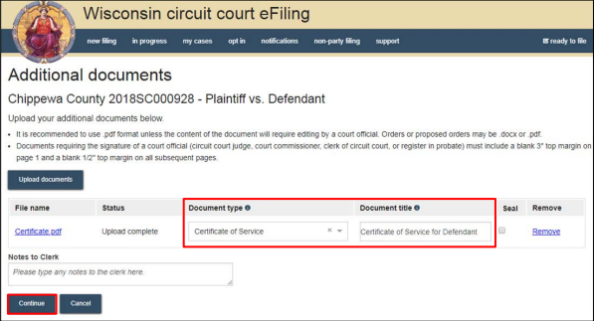
Annual Accounts and Annual Reports
Upload the documents you wish to file
Select the “document type” and give each document a title
Select “continue” in the lower left corner

Slide 16
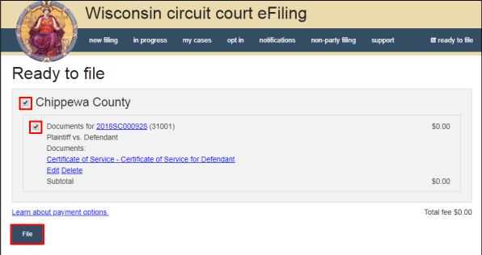
Annual Account and Annual Reports
On the “ready to file” page, check the appropriate boxes
Review and confirm the case number and documents you wish to file
Select “file” in the lower left corner

Slide 17
Annual Accounts and Annual Reports
As an Electronic Party to a case, you will also get an email from the court when the submitted document gets processed
You may also go back to the “my cases” tab and click “view documents” – if you were successful, the document should now show up in the case (if the document has not been processed by the court, it will likely say “submitted” or “awaiting court action” next to it).

Slide 18
Filing Monthly Budgets, Requests to Spend $500, Gifting Requests, Mileage Requests, etc.
Obtain the appropriate form from the Outagamie County Register in Probate Website
Fill out the document completely
Once filled out, save the document in word format (you will need the word document later)
Print the document, sign it, and prepare any necessary attachments
Take the signed Petition, including attachments, and scan and save it as a pdf.
Upload the pdf to the case and file as a “Petition”
Upload the word document you prepared and file it as a “Proposed Order”

Slide 19
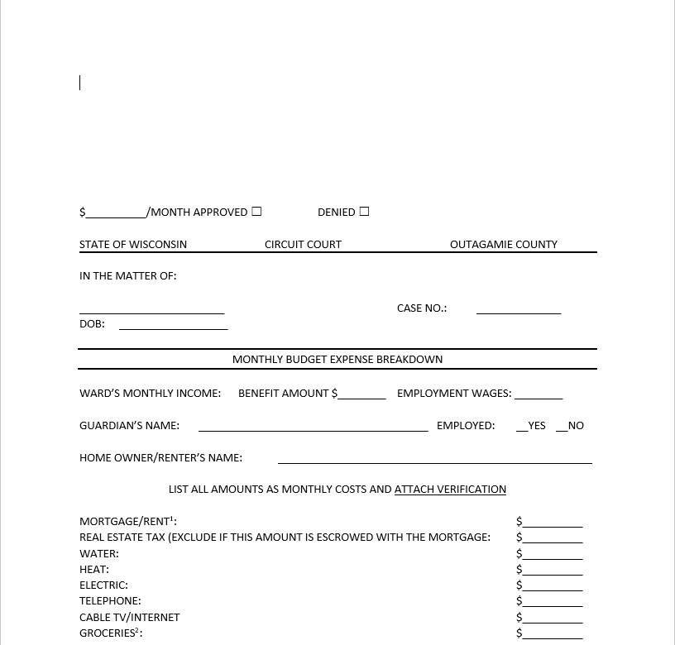
Filing a Proposed Order
Process is identical to filing other court documents with a few additional rules to keep in mind
Document must be filed as a word document
The document type must be proposed order
Document submitted must contain the 3” margin along the top
Once the document is submitted, the Court can
Modify the document and electronically sign the
Document. Once the document is electronically
signed and processed by the court, you will get it in
your email instantly if you are an e-filing party.
If you filed this as a non-party filer, the document will
But printed and mailed to you just like in the past.

Slide 20
Training Guides, Tutorials, and Resources
Visit https://www.wicourts.gov/ecourts/efilecircuit/train.htm
Contains handouts on how to create an e-filing account, opting-in, filing documents, filing proposed orders, as well as video tutorials to assist you for the steps involved in this process.
Frequently Asked Questions
How to contact support
e-mail support staff through the website
Online chat with support staff
Call support staff: 1-800-462-8843

Slide 21
Things to Remember
If notarization is required, you cannot use an electronic signature. You will need to sign the document in front of a notary and upload the signed paperwork as a pdf
Once opted in as an e-filing party – no more paper filing
Document Regulations
Files that are too large need to be broken up
Pdf vs. Word format – word documents are necessary for any proposed order so any needed modification can occur.
3” margin at the top of any proposed orders to allow for electronic signature
Separate scans for different type of documents – always submit the Annual Accounting and Annual Report as separate documents

